Slide 1
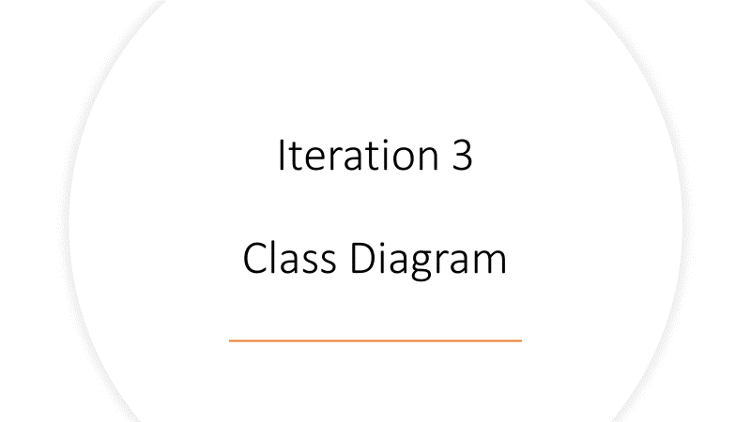
Iteration 4

Slide 2
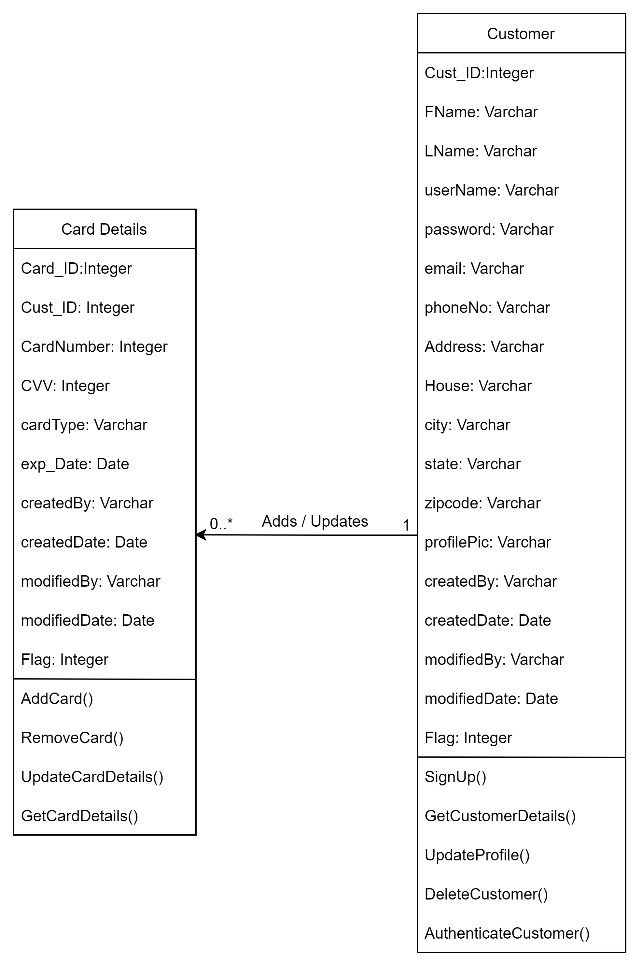
01.02 Modify user account details

Slide 3
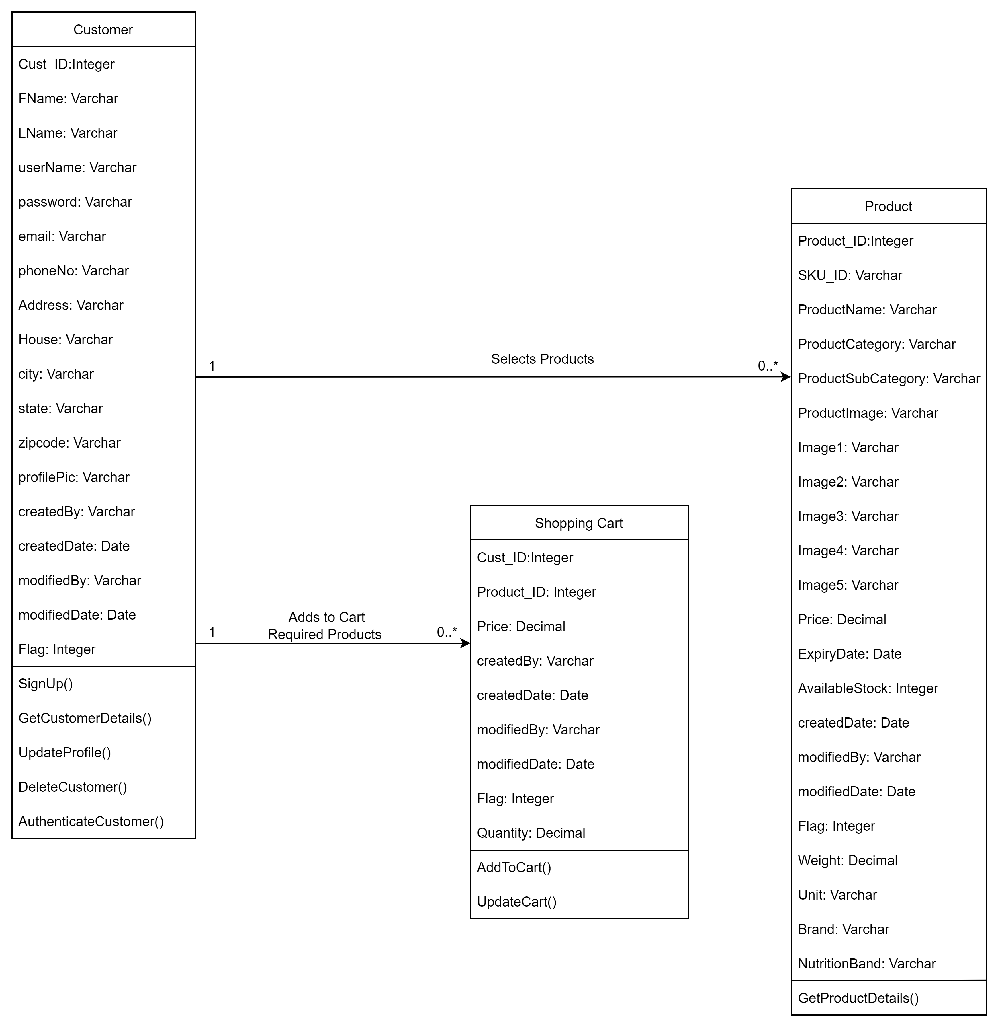
03.01 View/ Edit shopping Cart

Slide 4
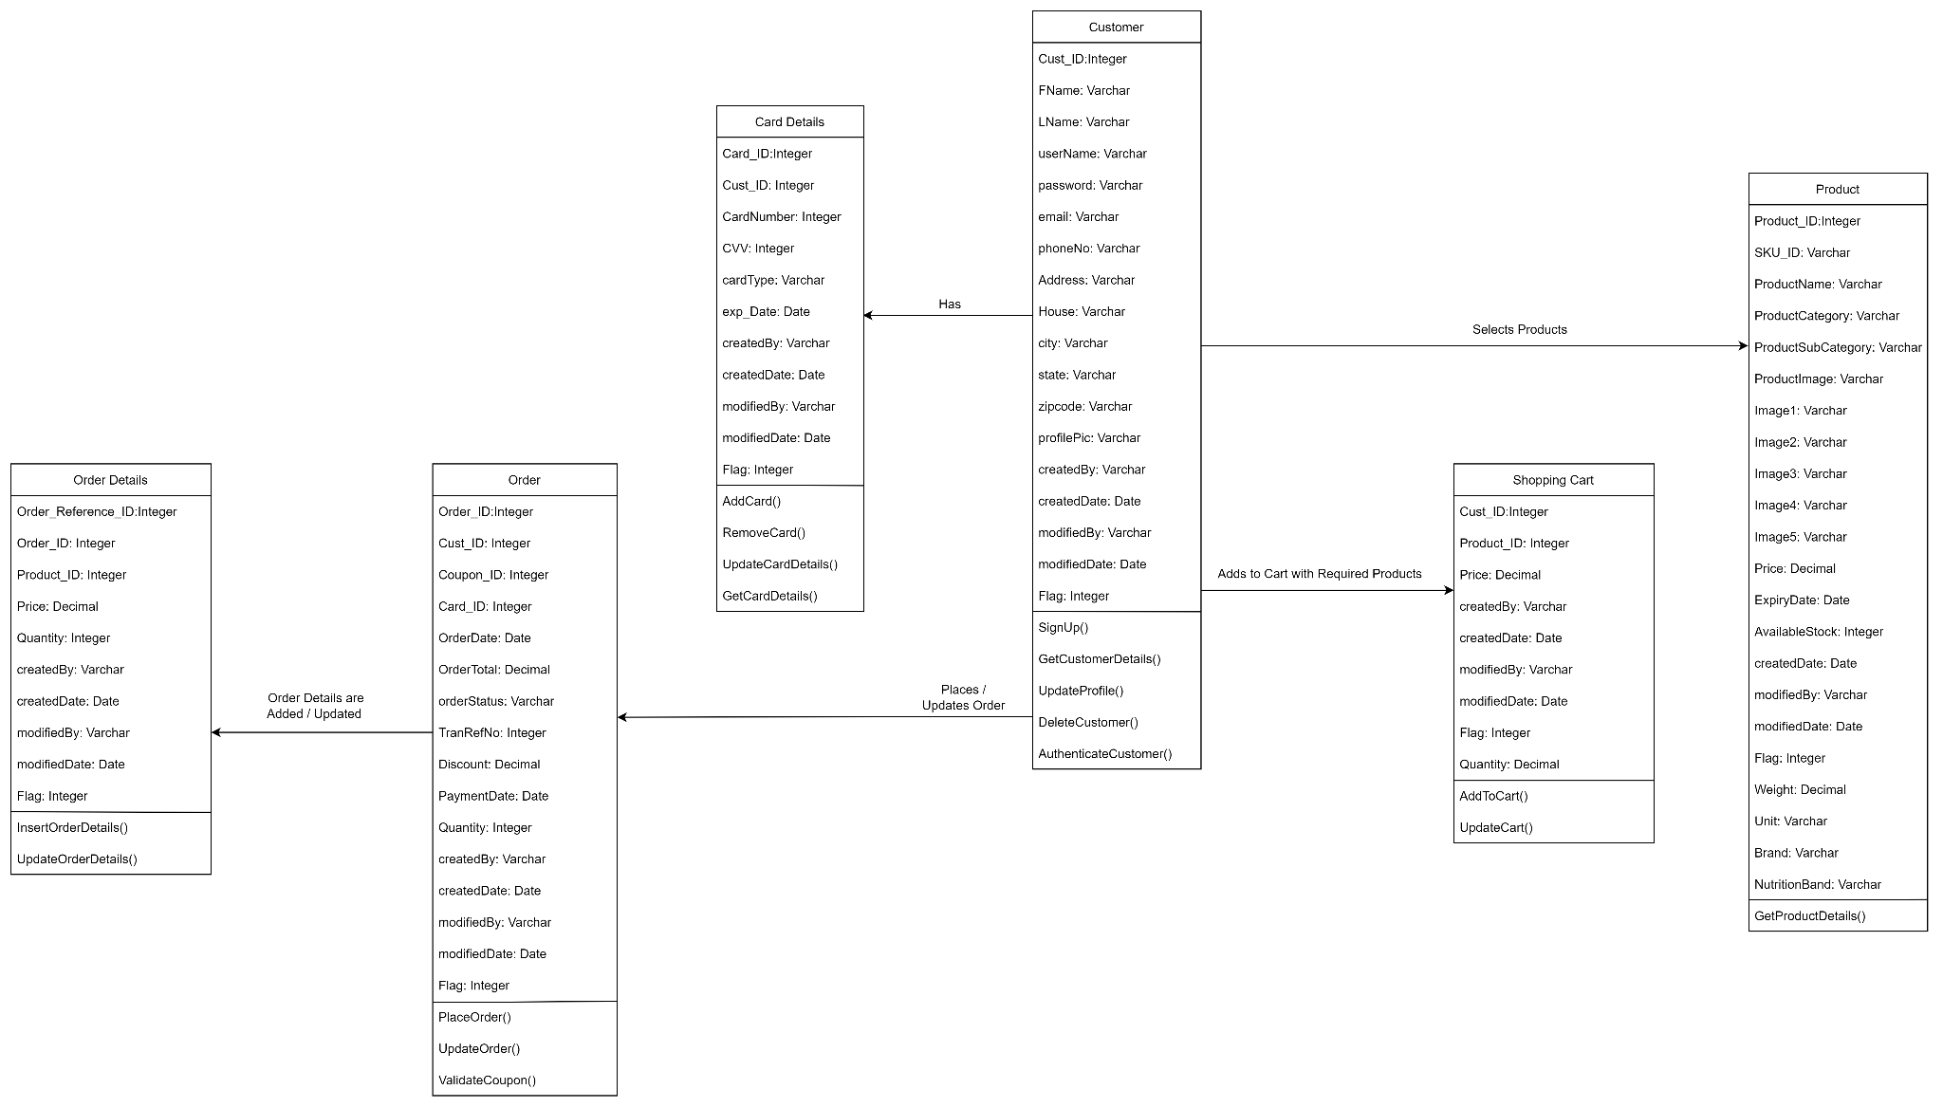
03.04 Submit Order
0..*
1
1
0..*
1
0..*
0..*
1
0..*
1

Slide 5
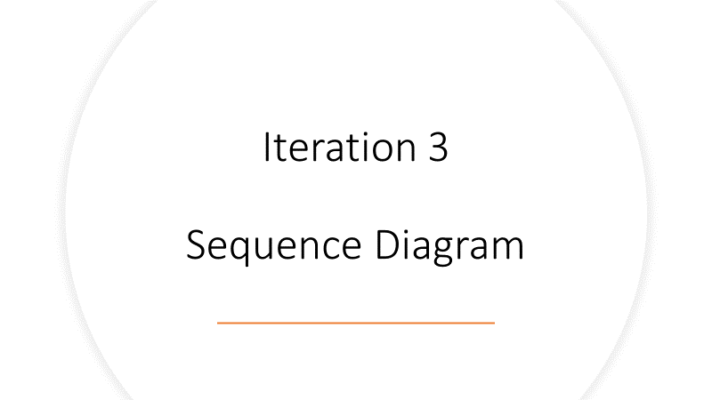
Iteration 4

Slide 6
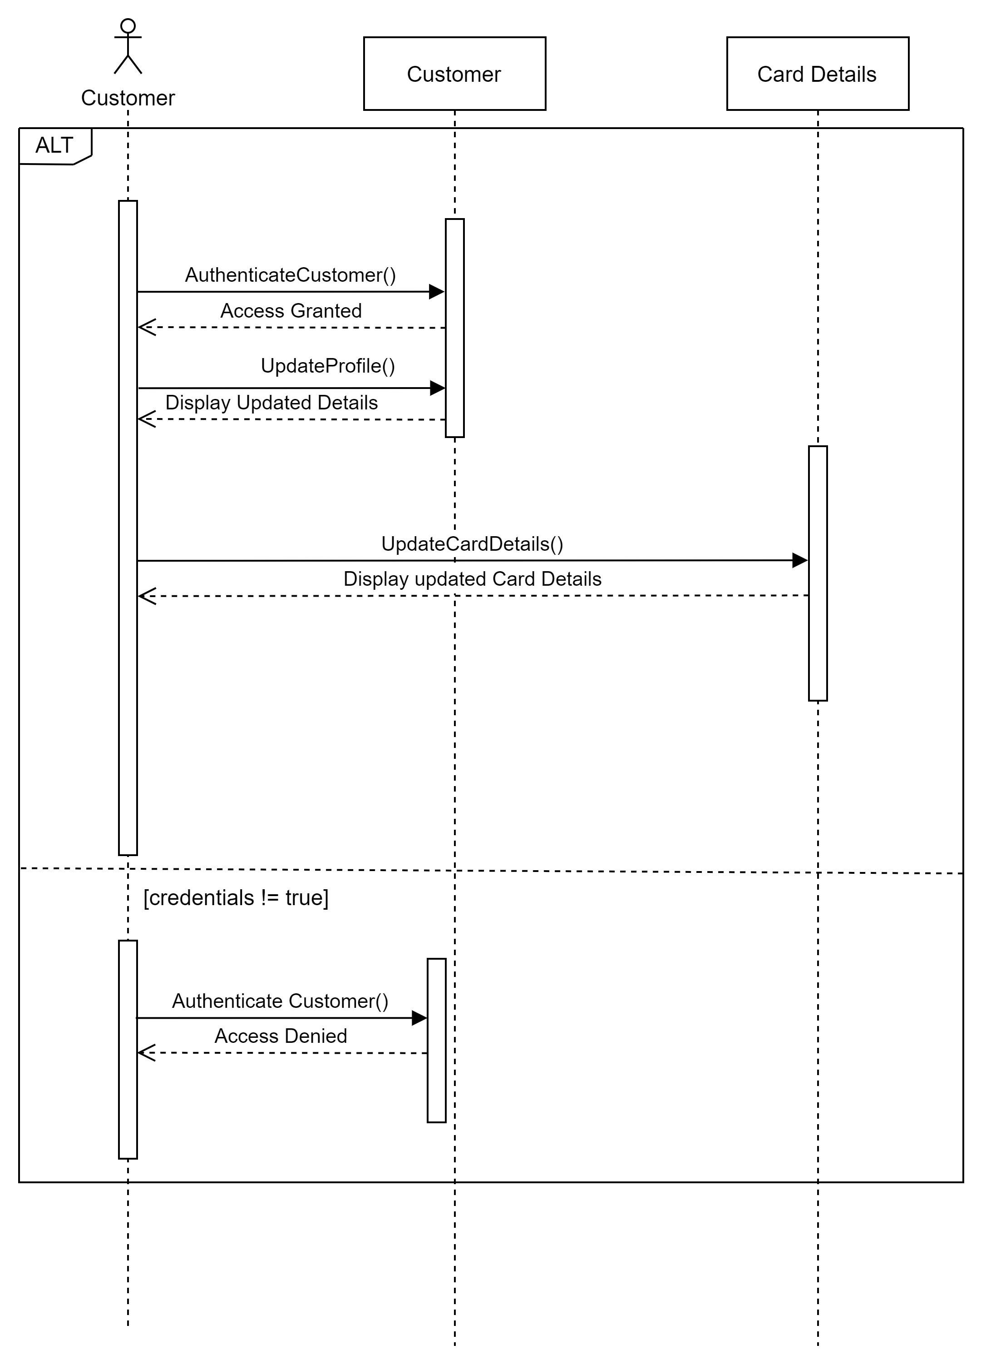
Flaunt Sequence Diagram – Team 02 01. Account Management Use Case : 01.02 Modify user account details
The use case begins with customer authenticating him / herself.
System returns access to account or returns access denied if the credentials entered are wrong.
Customer then selects the part of detail he wants to update.
Customer adds details to be updated.
System saves customer details in customer table in database.
After that customer wants to change his card details.
Customer adds new card details or updates the existing details
The system saves this details in card details table and sends message stating the details were updated or added and the use case ends here.

Slide 7
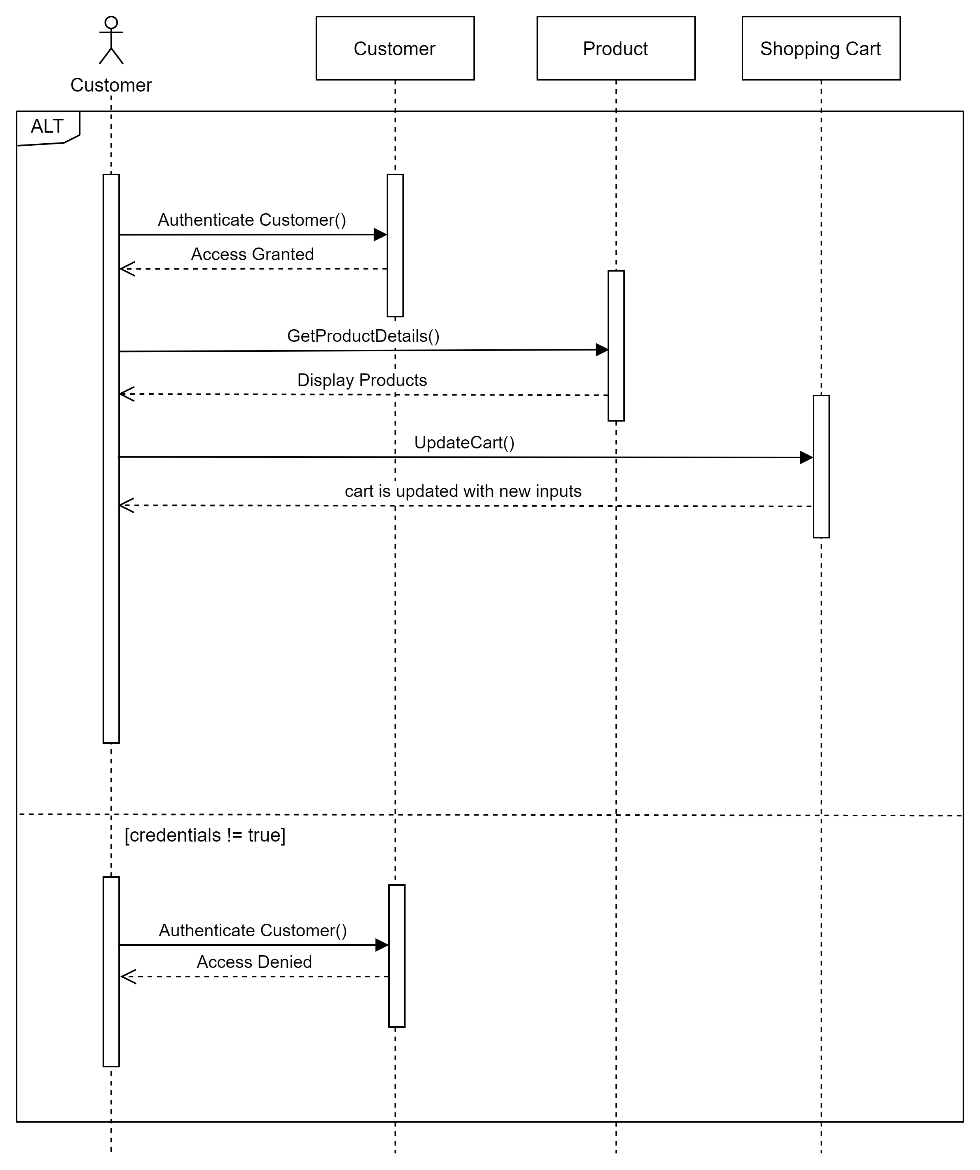
Flaunt Sequence Diagram – Team 02 03. Purchase Management Use Case : 03.01 View/ Edit shopping Cart
The use case begins with customer authenticating him / herself.
System returns access to account or returns access denied if the credentials entered are wrong.
Customer then searches product.
Customer adds products to cart and clicks on continue.
System saves customer product details in shopping cart table in database.
Customer then modifies the quantity of the product he added to cart.
System again updates the product details in the shopping cart table in database.
After adding to cart customer gets confirmation that products are modified in cart and this ends our use case.

Slide 8
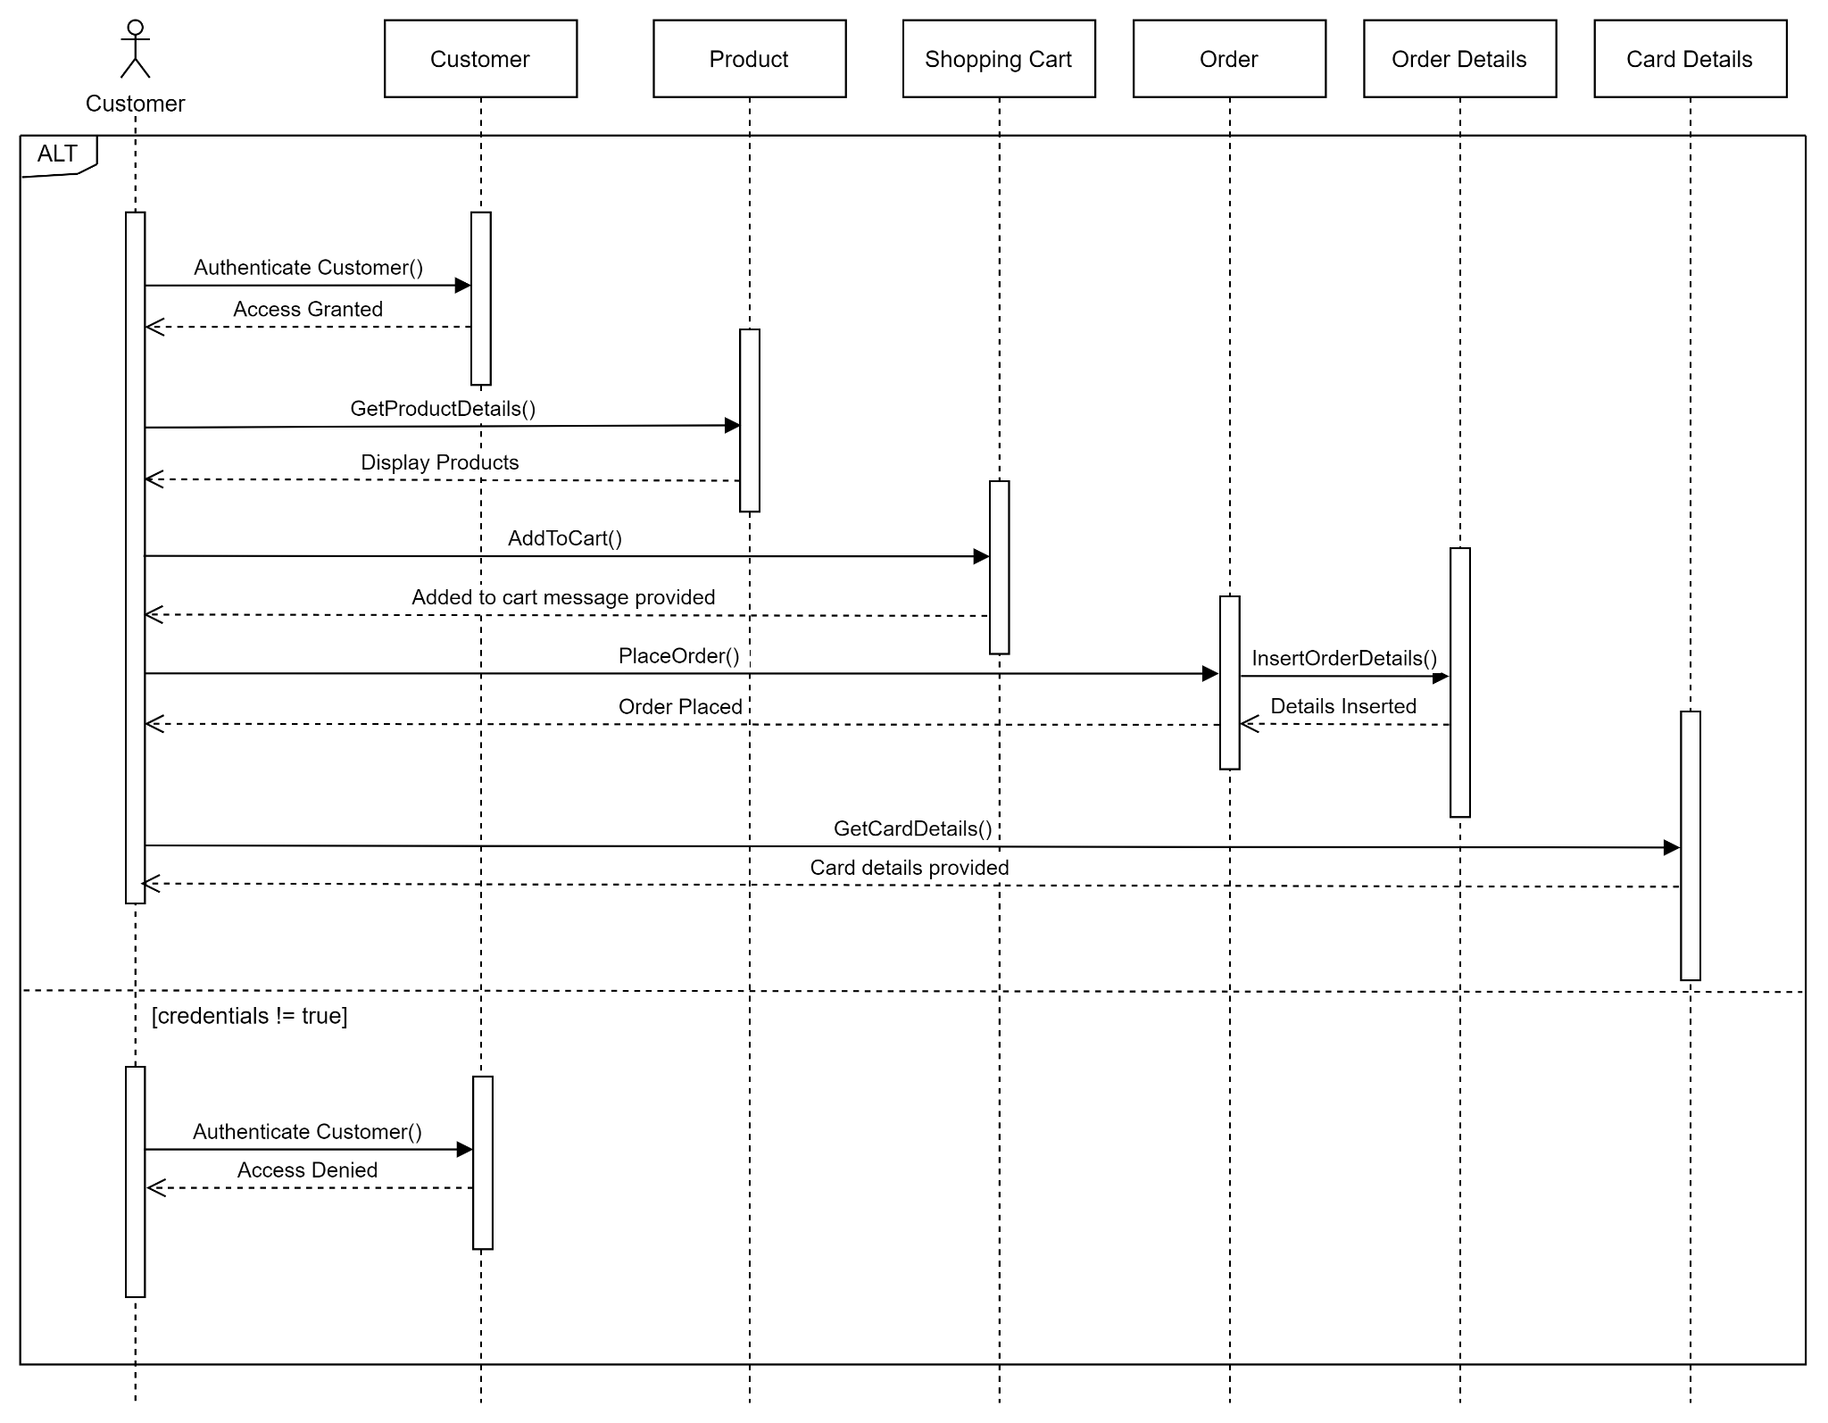
Flaunt Sequence Diagram – Team 02 03. Purchase Management Use Case : 03.04 Submit Order
The use case begins with customer authenticating him / herself.
System returns access to account or returns access denied if the credentials entered are wrong.
Customer then searches product.
Customer adds products to cart and clicks on continue.
System saves customer product details in shopping cart table in database.
After adding to cart customer gets confirmation that products are added to cart.
Customer confirms the products and then places order.
System then enters this customer details in Order table and in Order Details table, then directs customer to select card details.
Customer then Defines Payment Method by selecting the card details and then submits the order.
System saves the details and redirects the customer to confirmation page, providing the order confirmation message and use case ends there.

